Slide 1
Name- Chetan patil Topic- Docker

Slide 2
What is docker?
Docker is a software platform that allows you to build, test, and deploy applications quickly.
Docker packages software into standardized units called containers

Slide 3
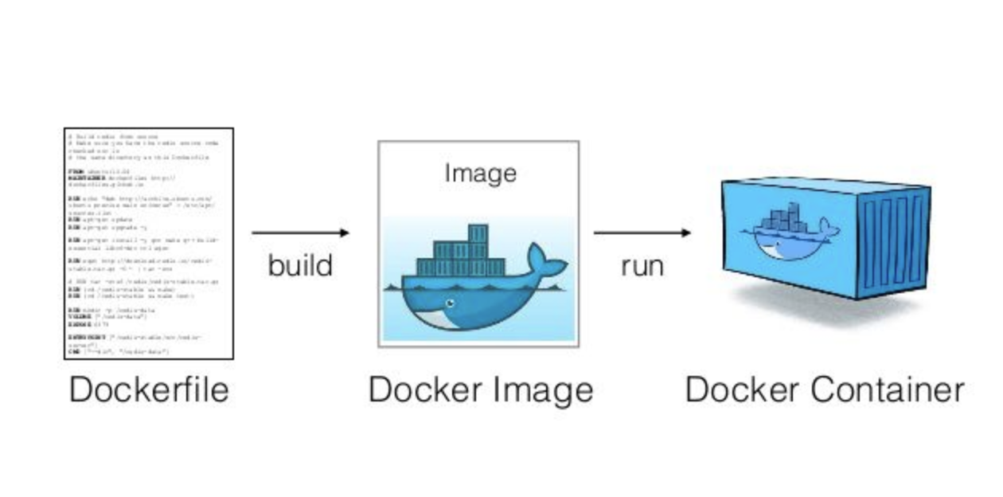

Slide 4
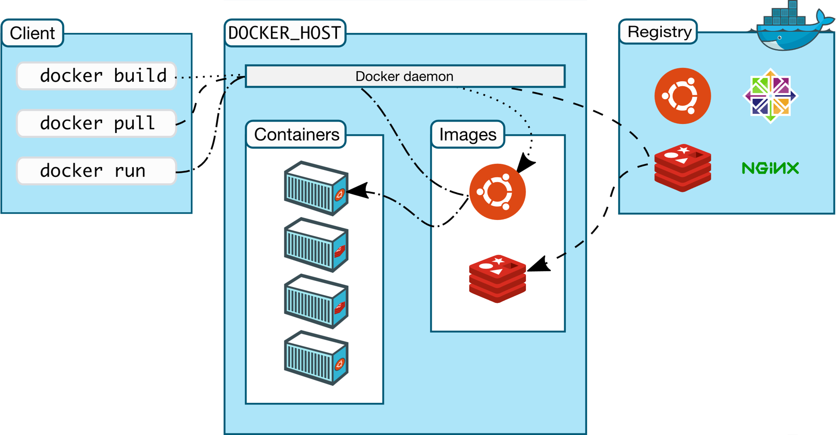
Docker uses a client-server architecture. The Docker client talks to the Docker daemon, which does the heavy lifting of building, running, and distributing your Docker containers.

Slide 5
● FROM: for a base image, the command must be on top of the docker ● RUN: To execute Command, it will create a layer in the image.
● MAINTAINER: Author/owner/description
● COPY: Copy files from the local system (docker VM) we need to provide a source, destination(We can't download file from the internet and any remote directory)
● ADD: Similar to copy but, it provides a feature to download files from the internet, also we extract files at the docker image side.
● EXPOSE: To Expose ports such as port 8080 for tomcat, port 80 for Nginx, etc. ● WORKDIR: To set a working directory for a container.
● CMD: Execute commands but during container creation
● ENTRYPOINT: Similar to CMD, but has higher priority over CMD, first commands will be executed by ENTRYPOINT only.

Slide 6
Docker image
When using Docker, we start with a base image. We boot it up, create changes and those changes are saved in layers forming another image.
An instance of an image is called a container.
We have an image, which is a set of layers as we describe. If we start this image, we have a running container of this image. we can have many running containers of the same image.

Slide 7
Manage image
Find an existing image in dockerhub $ docker search IMAGE NAME
● Download an image $ docker pull IMAGE[:TAG]
● Upload an image to a repository $ docker push IMAGE
● Delete an image $ docker rmi IMAGE
● Show the image history $ docker history image
● Show a list of all images $ docker images
● Delete dangling images $ docker images prune
● Delete all unused images $ docker images prune -a

Slide 8
Manage container
Show a list of running containers $ docker ps
● Show a list of all containers $ docker ps -a
● Delete a container $ docker rm CONTAINER
● Delete a running container $ docker rm -f CONTAINER
● Delete stopped containers $ docker container prune
● Stop a running container $ docker stop CONTAINER
● Start a stopped container $ docker start CONTAINE

Slide 9
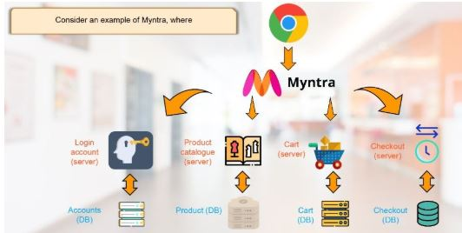
Docker compose file need

Slide 10
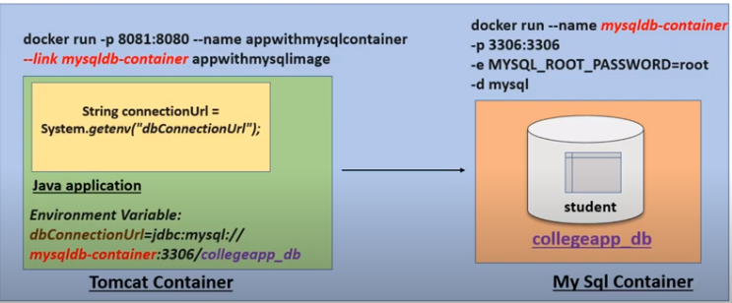
Pictorial presentation of liniking 2 container

